Slide 1
Neural Network
07/01/2021

Slide 2

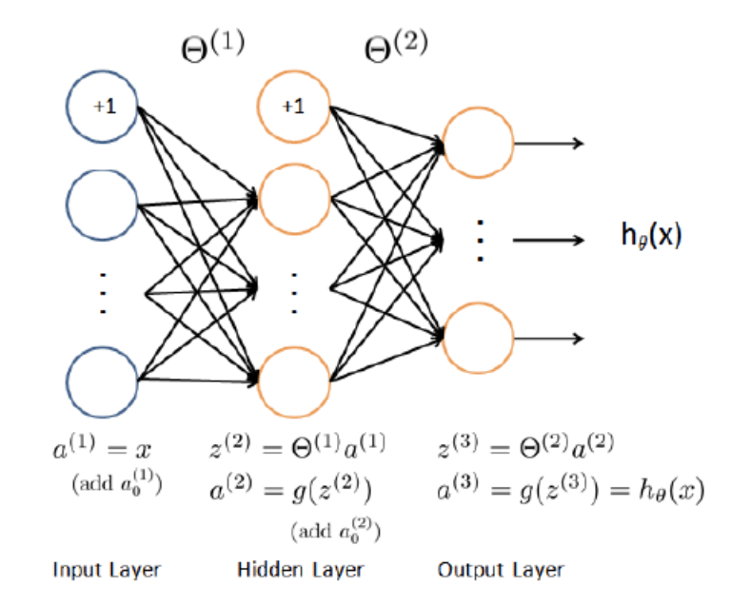
Model
17 * 34 * 3

Slide 3


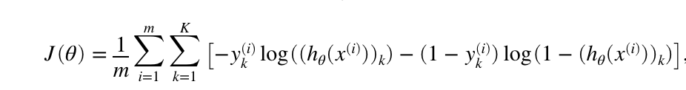
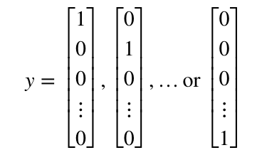

Cost Function – Forward Prop
K is the number of classes
y (i = 1, k = 1) = 1
y (i = 2, k = 1) = 0

Slide 4
Cost Function nn_params
nn_params = [Theta1(:) ; Theta2(:)];
Theta1 = [1 2 3;4,5,6;7,8,9]
Theta2 = [0,0,0]
nn_params = [1 2 3 4 5 6 7 8 9 0 0 0]

Slide 5
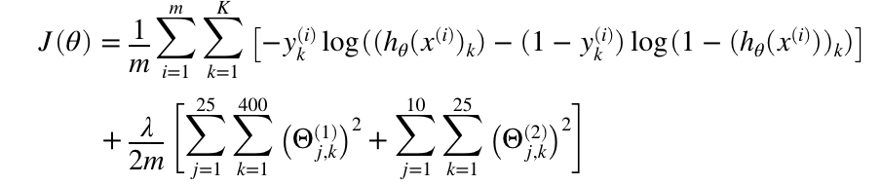
Cost Function (Regularized)
Features = 400
Second layer = 25
Output layer = 10

Slide 6
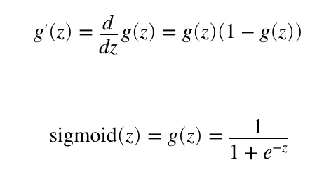
Sigmoid Gradient
Make a Function called sigmoidGradient

Slide 7
Initialize Thetas
epsilon_init = 0.12;
W = rand(L_out, 1 + L_in) * 2 * epsilon_init - epsilon_init;

Slide 8
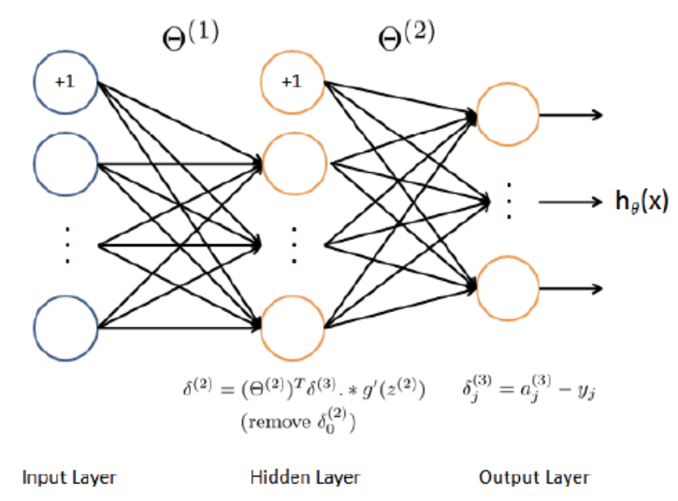
Cost Function (back prop)
Get Grads

Slide 9
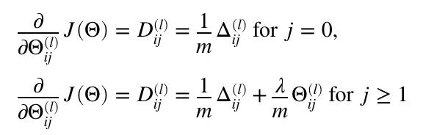
Regularized NN

Slide 10
Use fmincg Then Predict
See sample code

Slide 11
Data sets
2 outputs: 1,2
Polynomial 2nd and 3 rd power

